Slide 1
IBM MAINFRAMES
CICS Training Class-02

Slide 2
Macros used in BMS Mapset
PRINT NOGEN
Coded once at the beginning of the mapset; tells the assembler not to print the statements generated as a result of expanding the BMS macros.
END
Must be the last statement in the input stream; tells the assembler that there are no more source statements.

Slide 3
DFHMSD Macro
DFHMSD : To define the mapset and supplies values that apply to the entire mapset.
NAME DFHMSD TYPE={&SYSPARM | DSECT | MAP},
LANG={COBOL | ASM | PLI },
MODE={IN | OUT | INOUT},
TERM=terminal−type,
CTRL=(option, option...),
STORAGE=AUTO,
MAPATTS=(COLOR,HILIGHT),
DSATTS=(COLOR,HILIGHT),
TIOAPFX={YES | NO}
DFHMSD TYPE=FINAL

Slide 4
MAPSET Parameter Explanation
NAME : Used to refer the mapset in an application program.
TYPE : Specifies whether a physical map (MAP), Symbolic map (DSECT), or both (&SYSPARM) will be generated. TYPE=FINAL marks the end of a mapset.
LANG Specifies the programming language: COBOL, ASM , PL/I.
MODE Specifies whether the mapset is used for input (IN), output (OUT), or both (INOUT).

Slide 5
MAPSET Parameter Explanation
CTRL Specifies a list of control options in effect for each map in the mapset. Common options are:
  FREEKB Free the keyboard after each output operation.
  ALARM Sound the audio alarm .
  FRSET : To reset all the map filed values.
STORAGE If STORAGE=AUTO is coded, the symbolic maps for the maps in the mapset will occupy separate storage locations. Otherwise, they'll occupy the same storage location.

Slide 6
MAPSET Parameter Explanation
TIOAPFX : YES generates a 12−byte FILLER item at the beginning of the symbolic map that the system uses to maintain control information. YES should always be specified for COBOL maps (NO is the default).
MAPATTS / DSATTS Specifies which extended attributes should be supported by the symbolic map. COLOR and HILIGHT are the most common and are usually coded together.
TERM Specifies the type of terminal that will be supported by the physical map generated by this mapset. Common values are: ALL or 3270 Support for any terminal.

Slide 7
DFHMDI Macro
DFHMDI Coded once for each map within the mapset; supplies values that apply to a single map.
NAME DFHMDI SIZE=(lines, columns),
LINE=line−number,
` COLUMN=column−number,
CTRL=(option, option...)

Slide 8
MAP Parameter Explanation
NAME : The one− to seven−character name of the map. Each map within a mapset must have a unique name.
SIZE : Specifies the size of the map in lines and columns. Usually coded SIZE=(24,80)
LINE Specifies the line number on the screen where the map starts. Usually coded LINE=1.
COLUMN Specifies the column number on the screen where the map starts. Usually coded COLUMN=1.
CTRL Specifies a list of control options in effect for the map. Common options are: FREEKB . ALARM & FRSET

Slide 9
DFHMDF Macro
DFHMDF Coded once for each field (or attribute byte) within the map; specifies the position, length, and attributes of a screen field.
NAME DFHMDF POS=(LINE,COLUMN)
LENGTH=FIELD LENGTH
ATTRB=(PROT,NUM,IC,FSET,BRT)
COLOR=COLOR,
HILIGHT=HIGHLIGHT,
INITIAL=‘literal’,
PICIN=‘PICTURE-STRING’,
PICOUT=‘PICUTRE-STRING’

Slide 10
Map Field Parameter Explanation
NAME The 1− to 29−character name for the field. If omitted, the field is not included in the symbolic map.
POS Specifies the line and column position of the attribute byte.
LENGTH Specifies the length of the field, not including the attribute byte.
COLOR Specifies the field's color. You may specify DEFAULT for the terminal's default color, or you may specify BLUE, RED, PINK, GREEN, TURQUOISE, YELLOW, or NEUTRAL. If omitted, DEFAULT is assumed.
HILIGHT Specifies the field's extended highlighting. Valid highlighting options are BLINK, REVERSE, UNDERLINE, and OFF. If omitted, the default is OFF.

Slide 11
Map Field Parameter Explanation
INITIAL Specifies the starting value of the field. If omitted, the default is hexadecimal zeros (Low−Value).
PICIN Specifies a COBOL picture string that defines the format of the data on input, like PICIN='999V99'.
PICOUT Specifies a COBOL picture string that defines the format of the data on output, like PICOUT='ZZZ,ZZ9.99'.

Slide 12
Map Field Parameter Explanation
ATTRB : Specifies one or more attribute byte settings for the field. If omitted, the default is NORM, ASKIP. If one or more options are specified, the default becomes NORM, UNPROT.
BRT The field is displayed with high intensity.
NORM The field is displayed with regular intensity.
DRK The field is not displayed on the screen.
PROT The field is protected; data may not be keyed into it.
ASKIP The field is protected, and the cursor will automatically skip over it.
UNPROT The field is unprotected; data may be keyed into it.

Slide 13
Map Field Parameter Explanation
NUM Turns on the numeric lock feature so only numeric characters can be entered; the field is right justified and zero filled. If omitted, the field is assumed to be alphanumeric and is left justified and space filled.
IC Specifies that the cursor should be located at the start of the field.
FSET Specifies that the MDT bit in the attribute byte should be turned on before the map is sent to the terminal.

Slide 14
An Attribute Byte
Each field on a screen is preceded by an attribute byte that
controls the appearance and operation of the field.
The attributes byte determine a field's characteristics.
The protection attribute determines whether or not the user can
key data into the field. (PROT,UNPROT,ASKIP)
The shift attribute determines whether the keyboard is in
alphanumeric shift (NUM)
The intensity attribute controls how the data in the field is
displayed. (NORM,BRT & DRK).

Slide 15
The contents of an attribute byte
Bit positions | Functions | Bit settings
0-1 |  | Depends on the contents of bits 2−7
2-3 | Protection and Shift | 00 = Unprotected alphanumeric 01 = Unprotected numeric 10 = Protected 11 = Protected skip
4-5 | Intensity | 00 = Normal 01 = Normal 10 = Bright 11 = Dark (No display)
6 |  | Must be 0
7 | MDT | 0 = Field has not been modified 1 = Field has been modified

Slide 16
MDT Modified Data Tag
Modified Data Tag is the last bit of an attribute byte that says whether a field has been modified or not. Terminal sends a field data only if the MDT is on. Otherwise, the field value is not transmitted.
MDT's can be turned on by
  Specifying FSET as part of the attribute of the BMS map
  Moving a standard attribute, which contains FSET to the Symbolic map's attribute.
  Entering data into a field will turns its MDT On.

Slide 17
Skipper & Stopper Technique
BMS does not automatically generate attribute byte to mark the end of an unprotected field. The user have to do it himself using skipper / stopper field.
So after every unprotected field an unlabeled skipper/stopper field must be defined with attribute parameter as ASKIP/ PROT
Skipper filed : It’s a 1 byte filed with ASKIP (autoskip) attribute used to skip the cursor to the next unprotected filed.
DFHMDF POS=(Ln,Cn),ATTRB=ASKIP,LENGTH=1
Stopper filed : It’s a 1 byte filed with PROT (protect) attribute used to stop the cursor in order to prevent filed overflow.
DFHMDF POS=(Ln,Cn),ATTRB=PROT,LENGTH=1

Slide 18
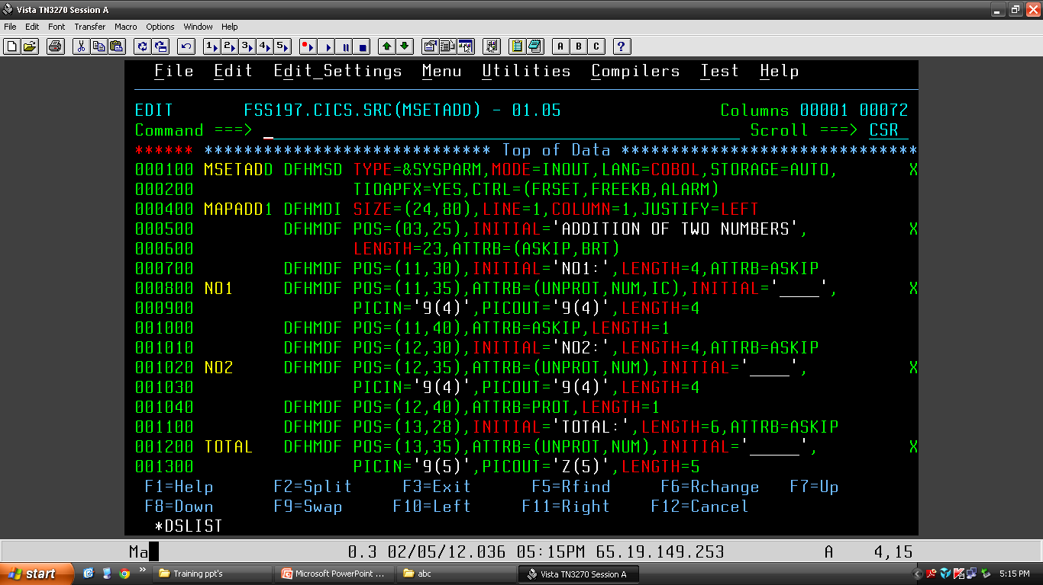
MAPSET PROGRAM

Slide 19
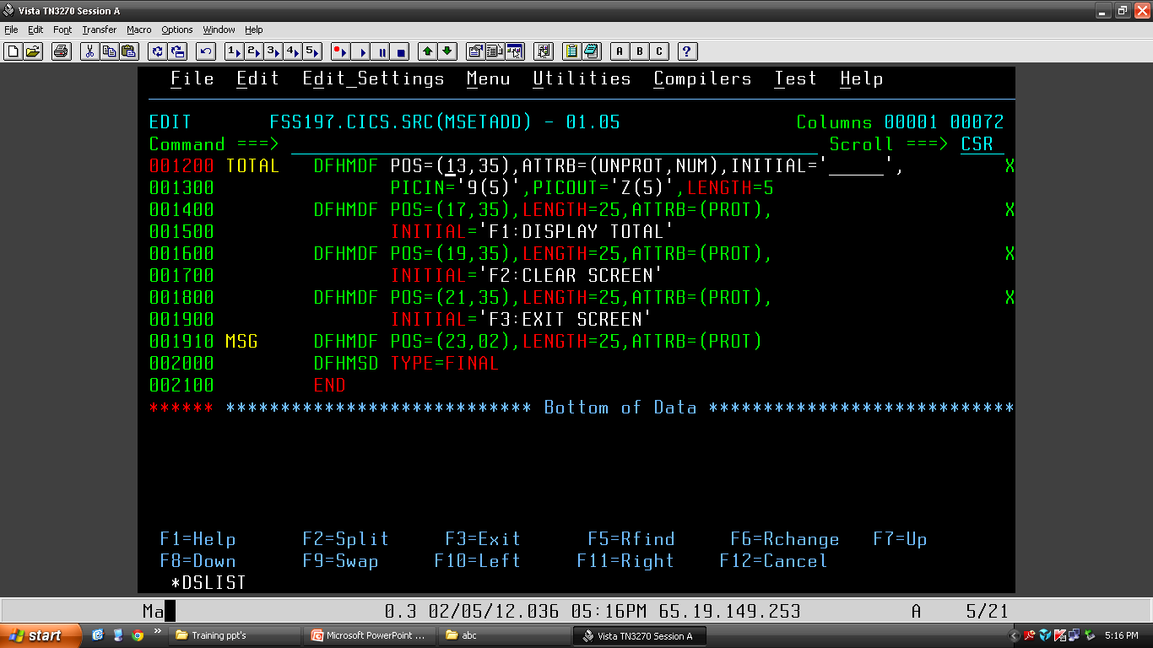
MAPSET PROGRAM

Slide 20
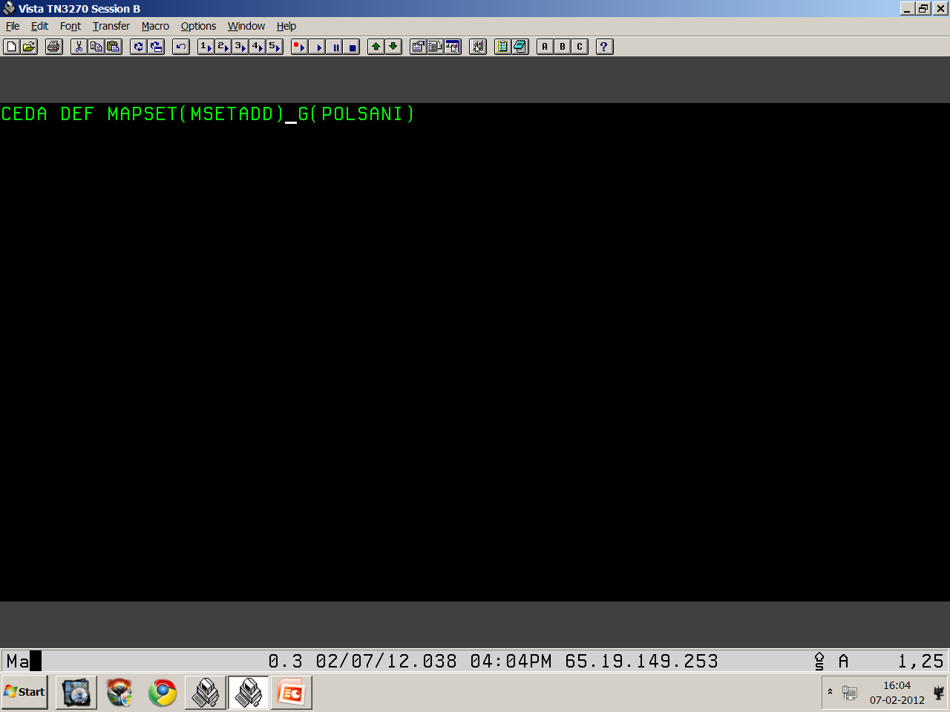
CICS Resource Definitions

Slide 21
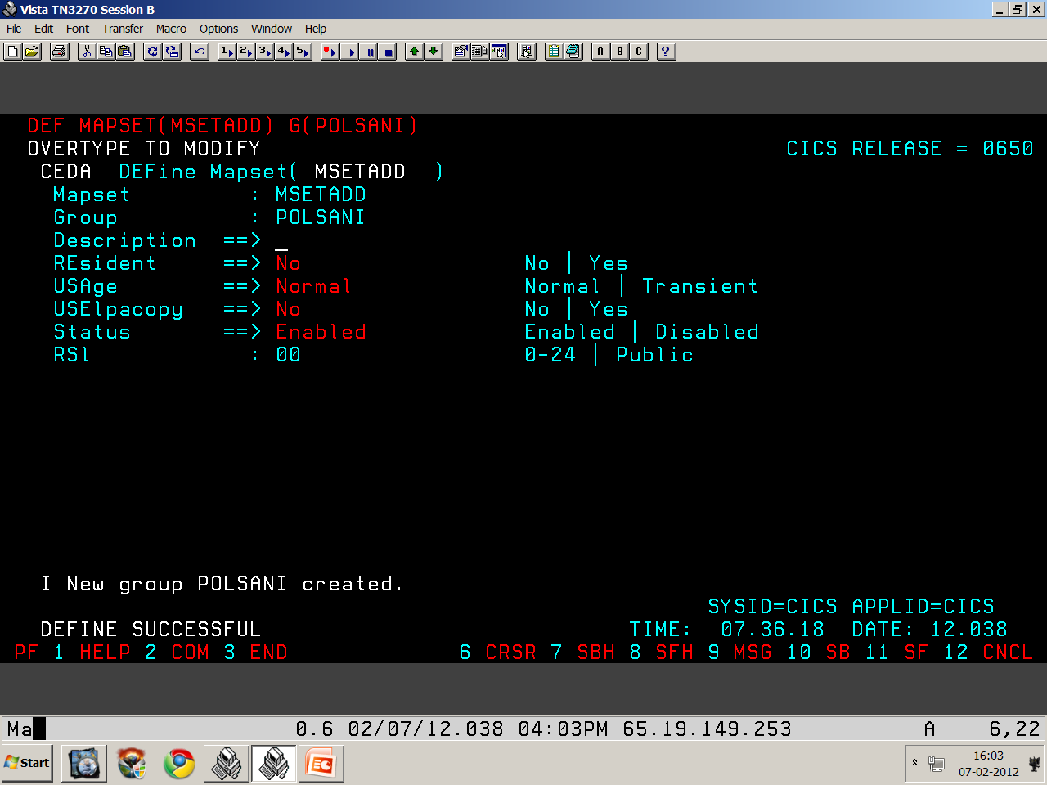
CICS Resource Definitions

Slide 22

CICS Resource Definitions

Slide 23
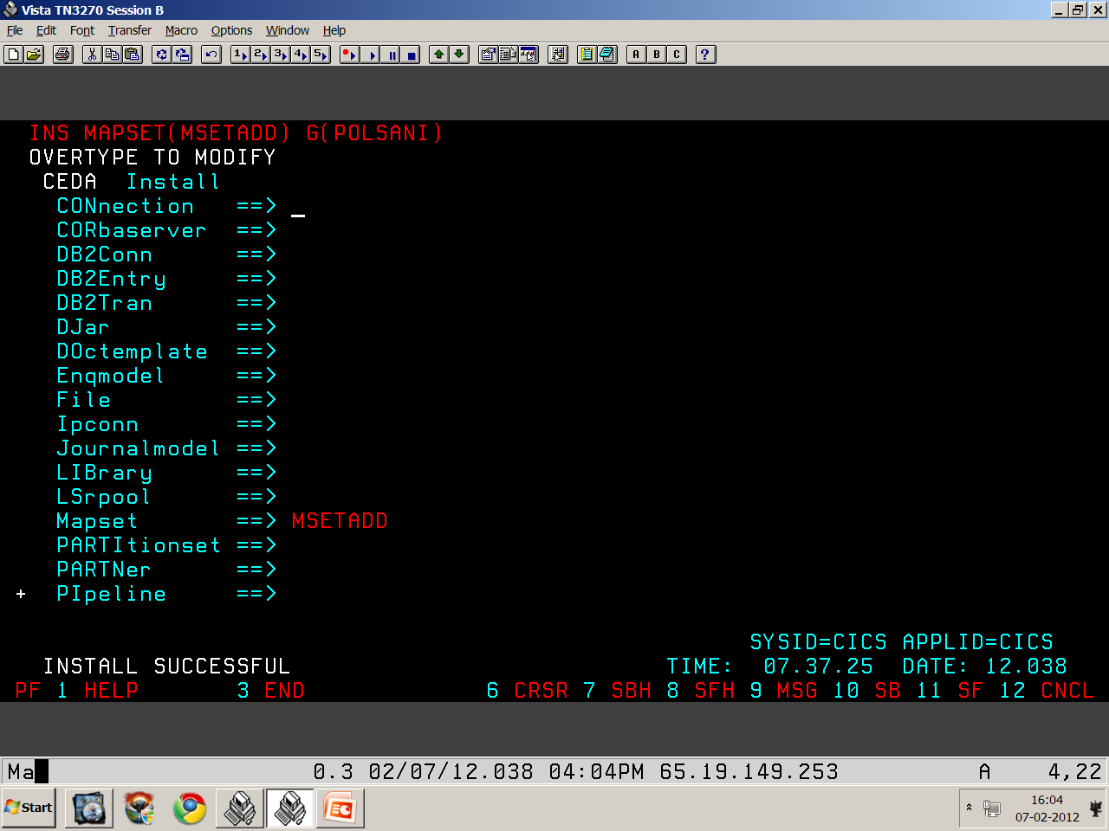
CICS Resource Definitions

Slide 24
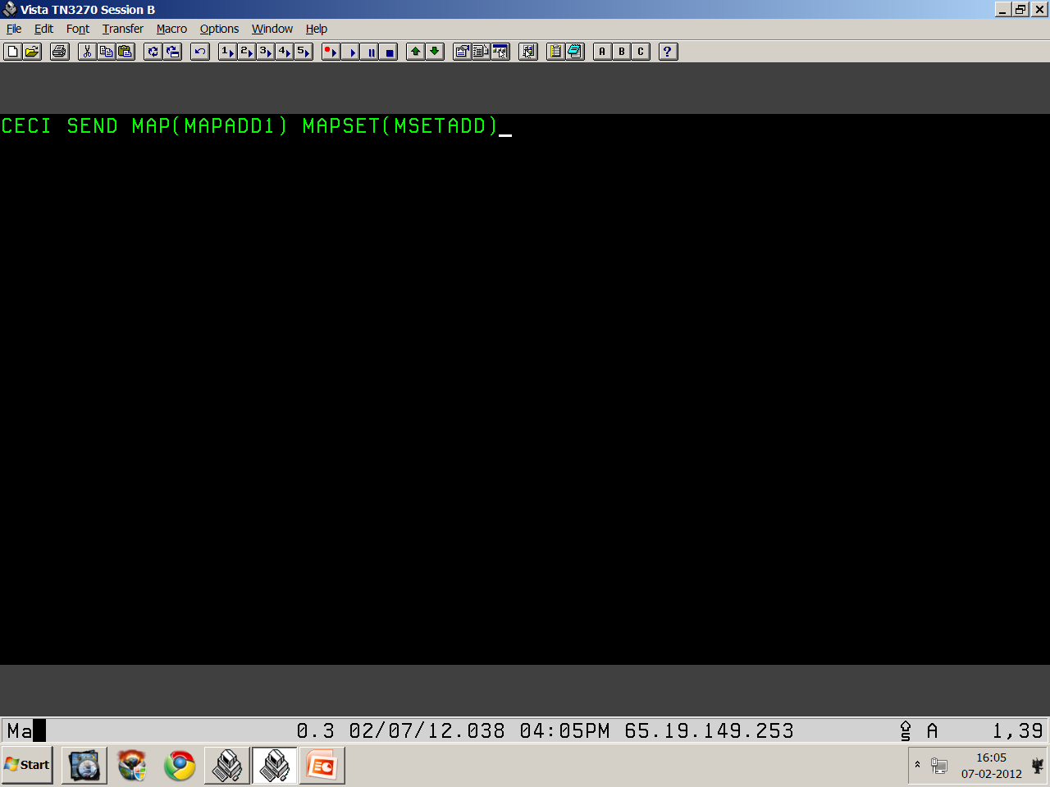
Viewing Map

Slide 25
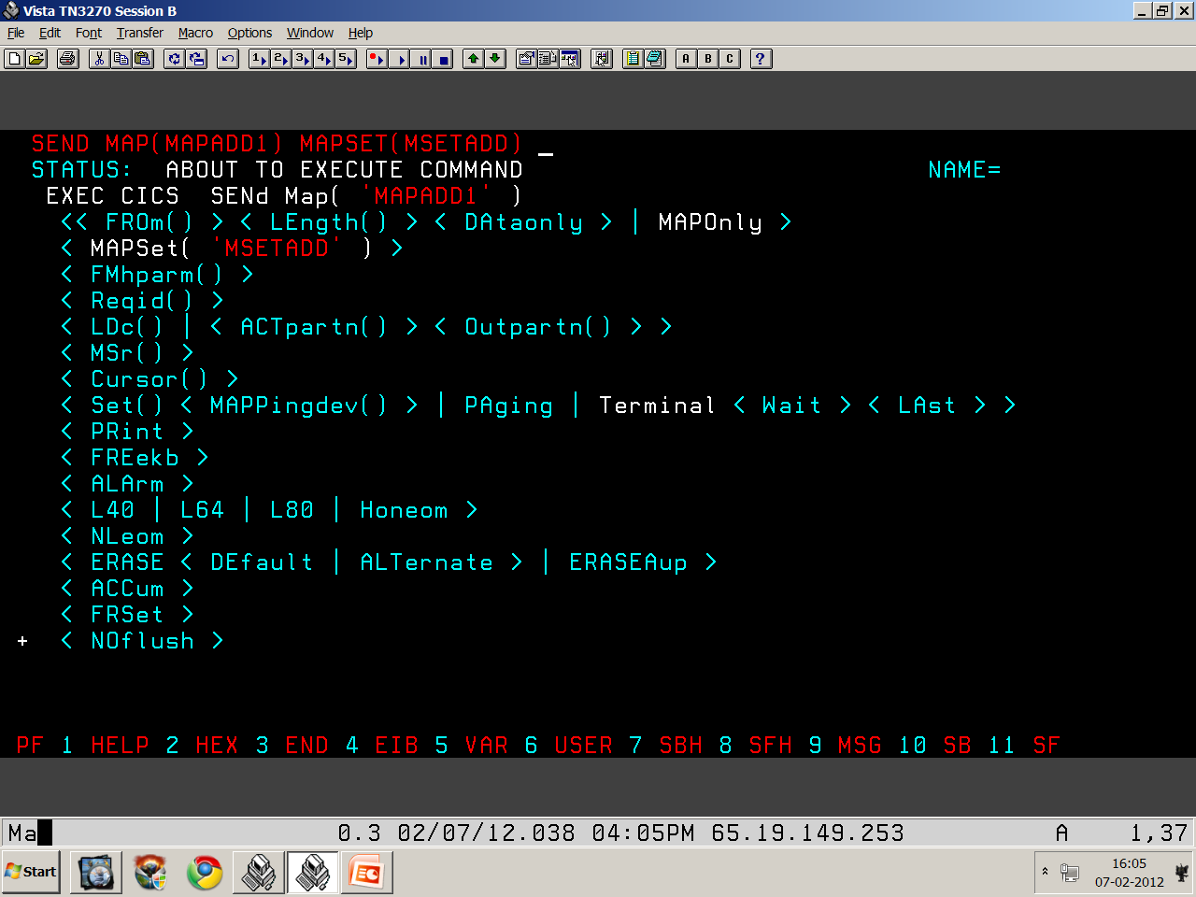
Viewing Map

Slide 26
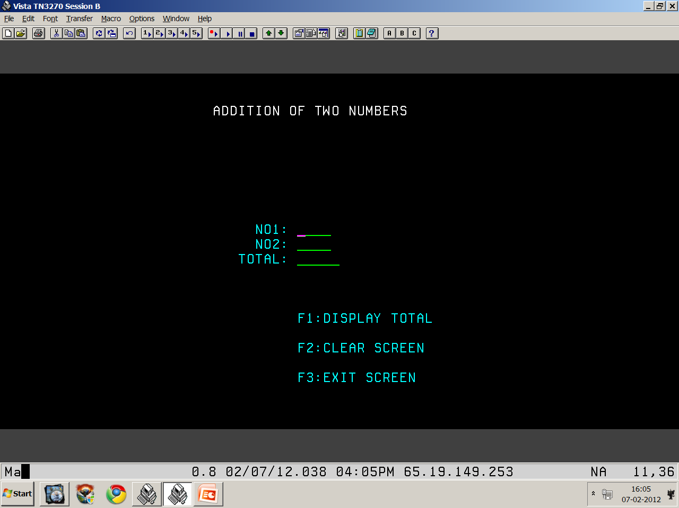
Viewing Map

Slide 27
Thank You
Polsani Anil Kumar

